Slide 1

E-rate 2021
Category 2 Budgets
Jennifer Peacock
Administrative Services Director
Sharmaine Frazier
State E-rate Coordinator

Slide 2
E-rate Category 2
Category 2 funding covers firewall, Wi-Fi management, wiring in the building, switches, routers, installation, configuration, maintenance, etc.
Click this link, Category 2 Eligible Services, for a complete list
MLC Technology staff will offer assessments to help determine any needs and work with you on procurements.

Slide 3
E-rate Category 2
Under Contract 4000, firewall was covered under
Category 1.
Under Contract 5000, firewall will be covered under Category 2.
This means that every system will now have to file for Category 2.

Slide 4
E-rate Firewall
Only basic firewall charges are covered under E-rate.
100 MB = $65 (85% means you pay $9.75 p/m)
1 GB = $280 (85% means you pay $42.00 p/m)
Then add $15 for advanced (IDS/IPS) not eligible for E-rate.
Then add another $15 for filtering not eligible for E-rate.
Plan on an additional $30 out of pocket per month.

Slide 5
Category 2 rules going forward are designed for greater simplicity
The Category 2 budget runs for a fixed five-year cycle, (i.e. FY 2021-2025, FY 2026-2030, etc.)
This means the system will need to reserve enough funding for firewall charges for five years. Remaining funds can be used for other eligible needs.

Slide 6
  Five Year Category 2 budgets will be calculated and administered at the library system level.
  The total five-year budget for a library system is calculated at $4.50 X the total number of square feet; or $25,000.00 minimum budget per library.
  Bookmobiles = $25,000.00

Slide 7
  Doing the math...
  If your library square footage is 5,555 or less, you will be allocated $25,000 in funding.
  If your library square footage is 5,556 or more, you will be allocated funding by the square foot ($4.50 per square foot).

Slide 8
Exceptions
Systems with 10 libraries or less, have a hybrid option for calculating budgets for individual libraries using the $4.50/sq. ft., and the $25,000 minimum calculation, then adding them all together for a total budget.
Systems with 11 libraries or more, can only use the $4.50/sq. ft., then add them all together for a total budget.

Slide 9
New Change
Budgets are calculated and administered at a system level.
This means once you have total funding, you can spend it as you choose at any of your locations. You do not have to designate each branch their square footage funding.

Slide 10
Review, Correct or Enter your Library Square Footage
Based on the new changes for Category 2 budgets, all libraries will need to modify the organization information in the portal to review, correct, or enter the square footage of the library or libraries.
Do not leave this field empty!
Also, revise any other incorrect information by updating your Form 498.

Slide 11
FCC FORM 498 ID Management
USAC strongly encourages all libraries to review their FCC Form 498 data on an annual basis, and revise as necessary
Contact person change (for programs, remittance, General Contact, or Company Officer)
Address change (for programs, the General Contact, or Company Officer)
Banking and remittance information on file change
Change to how remittance statements are received
Change to a Tax ID, DUNS Number, CORES ID, business structure, or business type
Merger or consolidation of one 498 ID into another

Slide 12
Changing your square footage in one portal
Steps to View or Edit your square footage for libraries:
1. Log in to EPC.
2. Go to My Applicant Landing Page.
There are several ways to view or make changes:
* Click on the Welcome to Library system under Logo at top right.
* Click on My Entities located at bottom of page to change individual branches information.
* Library systems can click on Related Actions from the horizontal menu across the top of the
page.
* Select Manage Organization to open and manage the library system profile information.
* To manage individual originations, after clicking Related Actions, you need to click on
Manage Organization.
3. View or Edit any information needing an update.

Slide 13
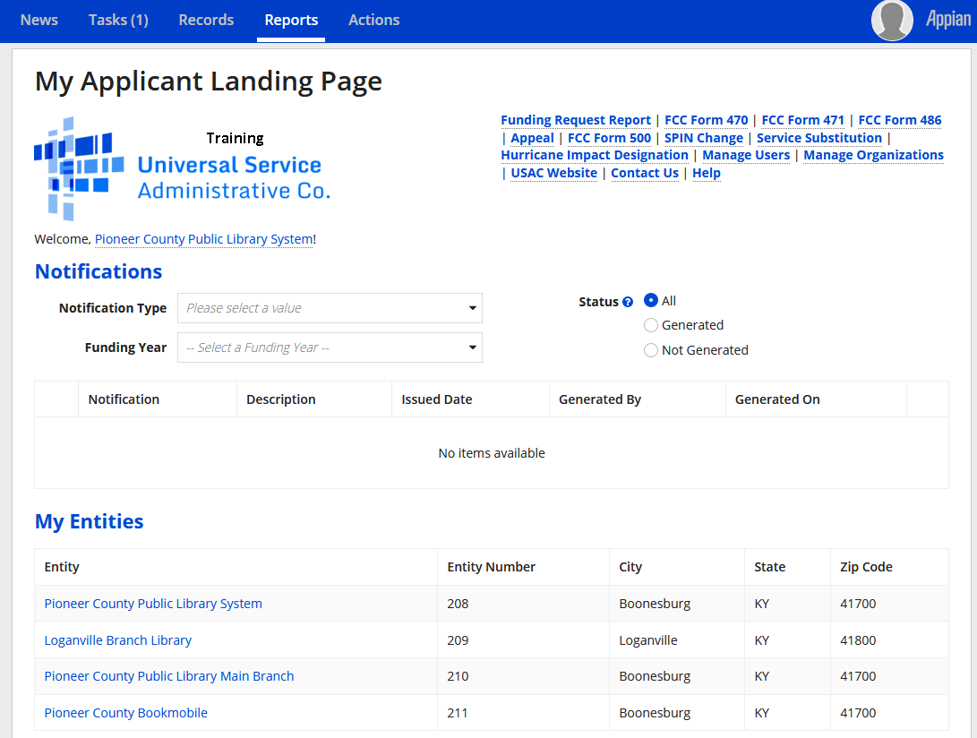
Updating profiles
To update the address, phone, square footage, or other information about your system or its branches, go to My Applicant Landing Page and click on the library system or branch name under My Entities.

Slide 14
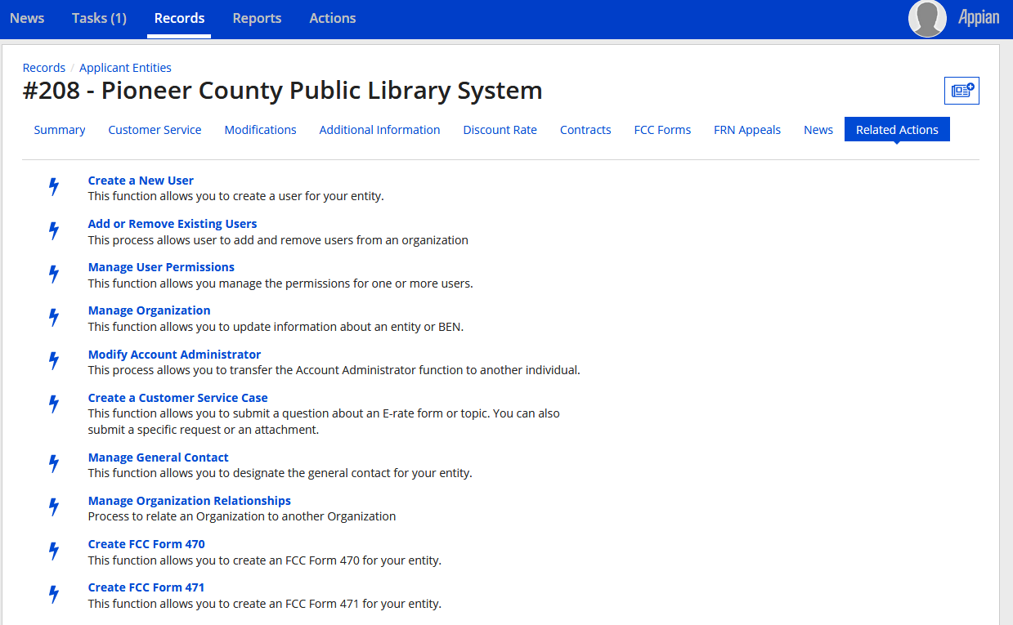
Updating
library system profile
FOR LIBRARY SYSTEM PROFILES: After following the profile link from My Applicant Landing Page, click on Related Actions from the horizontal menu near the top of the page. Select Manage Organization to open & modify the library system profile information.

Slide 15
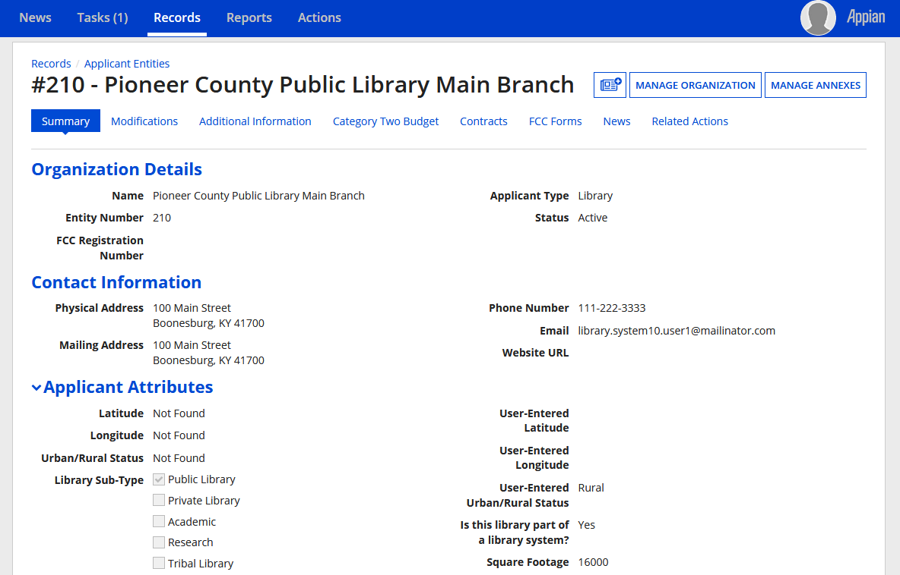
Updating branch profiles
FOR INDIVIDUAL BRANCH PROFILES: After following the link from My Applicant Landing Page, click on the Manage Organization button to modify the entity’s profile. Alternative: click on Related Actions in the horizontal menu, then click on Manage Organization.

Slide 16
Keeping up with your Category 2 Budget
Remember to reserve enough funds for five years to cover your firewall charges.
Talk with your staff or MLC Tech Staff to determine other needs that can be funded with E-rate.
  You may find with faster speeds and VOIP phone services (not covered by E-rate) that your wiring needs to be upgraded.
If you have an expiring contract during the five-year cycle, make sure to plan funding accordingly.
Remember to file a Form 500 if you need to release any funding you were committed and did not use.

Slide 17
References:
https://www.usac.org/e-rate/
https://e-ratecentral.com/Resources/Newsletters/News-of-the-Week/ArticleID/1974/December-9-2019

Slide 18
Questions?

