Slide 1
Makerspaces: 101
Charlie Simpkins
Digital Consultant,
Mississippi Library Commission
Notes:
Hello. My name is Charlie Simpkins and I am a Digital Consultant with the Mississippi Library Commission. Makerspaces have become a buzzword as of late, but their history could go back to 2005 when Make: Magazine was first published, or even further, but will get to that later. Since that time, makerspaces, a term often used interchangeably with fad labs and hackerspaces, have become much more prevalent. Today, I am going to discuss the basics of makerspaces.

Slide 2
What is a makerspace?
Collaborative work space
Inside school, library, or separate public/private facility
For making, learning, exploring, and sharing
High tech to no tech tools
Get creative with DIY projects, invent new ones, and share ideas
Share materials and information
Learn new skills
Not defined by specific materials, but by the people it serves
Notes:
The term ”makerspace” is a difficult term to define, as there is not a universal definition. So, I am going to look at a few definitions, looking at what I consider the most important parts.
Makerspace.com defines makerspaces as “ a collaborative work space inside a school, library or separate public/private facility for making, learning, exploring and sharing that uses high tech to no tech tools.” The highlights of this definition are that makerspaces are
a collaborative work space
they can be located in schools, libraries, or public or private facilities
They are for making, learning, exploring, and sharing
High tech to no tech tools
Open Education Database states that makerspaces “are collaborative spaces where people gather to get creative with DIY projects, invent new ones, and share ideas.” We see the continued emphasis of collaborative spaces in this definition. We also see highlighted that makerspaces promote:
Getting creative with DIY projects, invent new ones, and share ideas.
Dartmouth Libraries website states makerspaces “are collaborative learning environments where people come together to share materials and information, and to learn new skills. Makerspaces are not defined by a specific set of materials, but rather a mindset of the communities they serve.” The highlights of this definition are:
Share materials and information
Learn new skills
I believe the most important take-away about makerspaces is reminiscent of libraries, and that is that they are “not defined by specific materials, but by the people it serves”. A library is not defined by it’s collection of resources, but by the community it serves, and makerspaces are the same way.

Slide 3
What is needed?
“To invent, you need a good imagination and a pile of junk.”
- Thomas Edison
Notes:
What do you need to start a makerspace? Let’s first think back about what the purpose of makerspaces is, and that is to create/invent. Thomas Edison was quoted as saying, “To invent, you need a good imagination and a pile of junk.” I believe this could be the motto of makerspaces. It’s about looking at things with a new lens. If you’ve seen ”The LEGO Movie”, you can think of makerspaces as a place for Master Builders, a place where you can look at objects at a base level and discover new ways for them to interact.

Slide 4
What’s needed?
Cardboard
Tape
Wood craft sticks
Straws
Clips
Hook and Loop
Paper cups and plates
Rubber bands
Scissors
Plastic bottles
String
Glue
Toothpicks
Fabric
Paper
Clay
Etc.
Notes:
But seriously, what is needed? The great thing about makerspaces is that resources can be everyday materials. I’m only going to elaborate on a few of the items listed. Cardboard is all around. From cereal boxes to delivery boxes, from paper towel tubes to wrapping paper tubes, save them and build up your resources. Tape comes in such a variety, but start with what you have: transparent tape. Add other types as you can, such as duct tape, painters tape, and washi tape. Straws refer to drinking straws or stirring straws. Clips can be paperclips or binder clips. Hook and loop is the technical name for Velcro, but any brand can work. Collect different types of string, such as fishing line, yarn, and twine. Makerspaces can use school glue, hot glue guns, or even contact cement. The point is makerspaces can use whatever materials you have available.

Slide 5
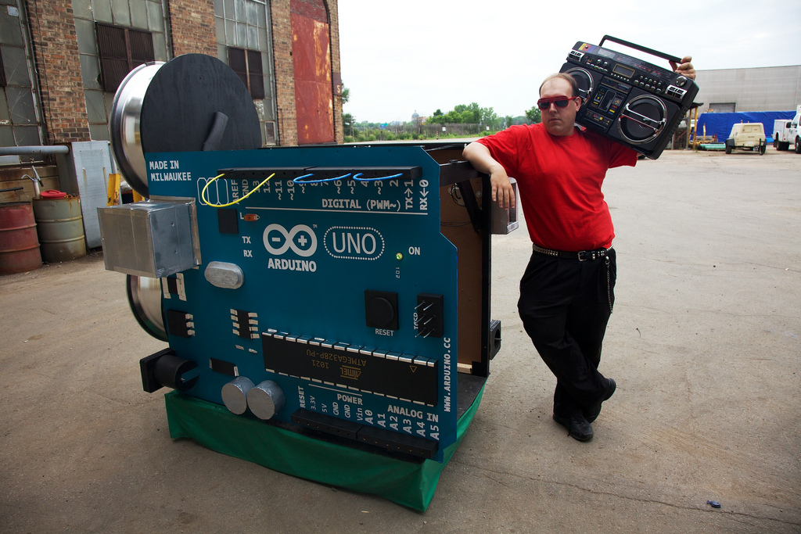
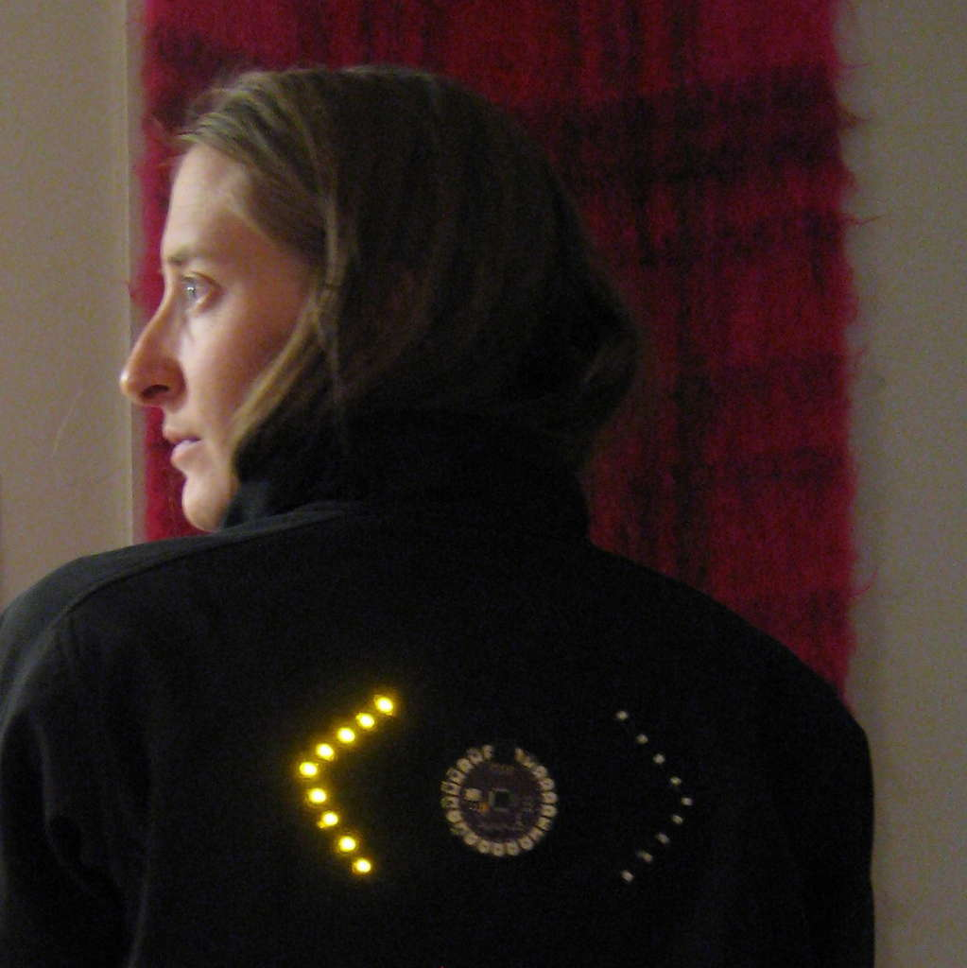
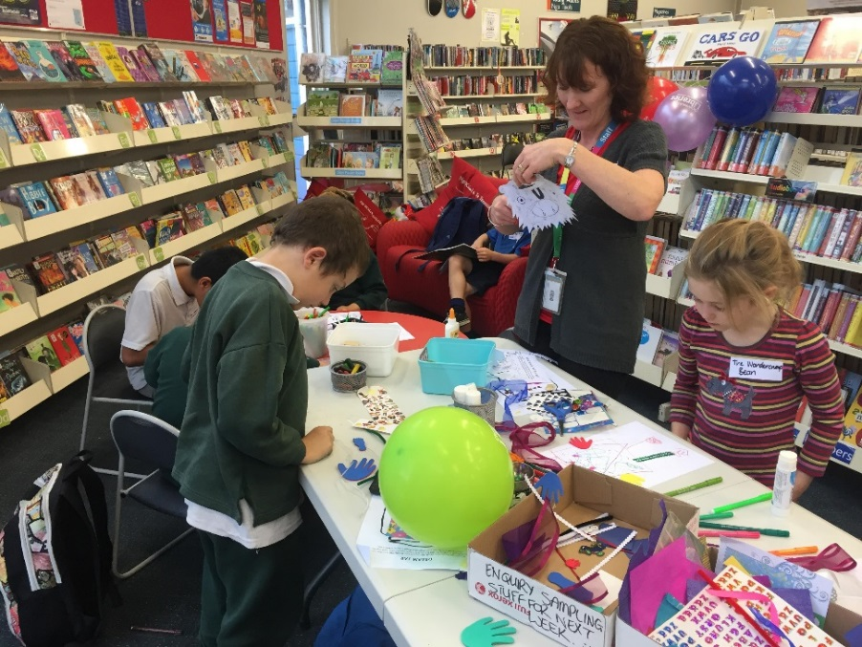
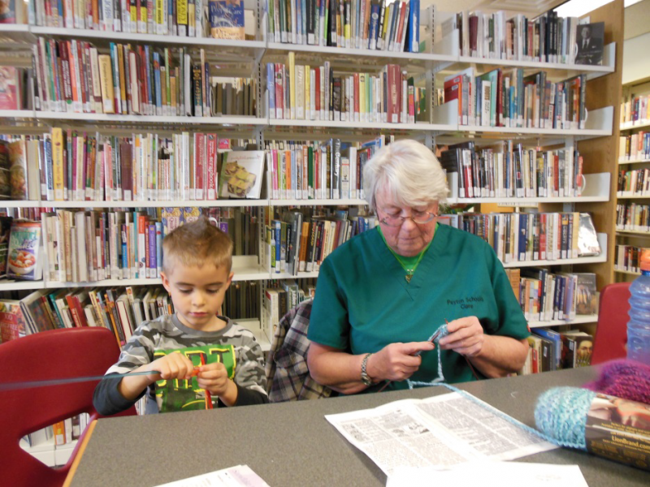
What does one look like?
This Photo by Unknown Author is licensed under CC BY-SA
This Photo by Unknown Author is licensed under CC BY
This Photo by Unknown Author is licensed under CC BY-NC-ND
This Photo by Unknown Author is licensed under CC BY-SA-NC
This Photo by Unknown Author is licensed under CC BY
This Photo by Unknown Author is licensed under CC BY-SA
Notes:
What does a makerspace look like? When I first heard of the term, I was intimidated. I thought I would need to become an expert about everything electronics. But at it’s essence, makerspaces are about learning, even for the host. Setups will depend on what materials are being used. For instance, have a table or two set aside, maybe one for materials and the other for workspaces. Give people access to various materials. Let them work together to create something new, or something they’ve seen before. A button maker could also be incorporated into the makerspace, possible creating promotional material for their new creation. At it’s core, makerspaces are about sharing experience and learning a skill. Bonding while learning to knit or crochet could easily be the basis of a makerspace. These skills can be incorporated into wearable technology, such as creating a turn signal biking jacket.

Slide 6
Bronze Age Orientation Day
Notes:
A makerspaces new? Not really. Anytime a group of people get together and share their skills and experience, they are creating a makerspace. I’ve included a video to demonstrate how long makerspaces have been around. Link is available here: https://www.youtube.com/watch?v=6O6jbZ_fdrY.

Slide 7
Summarize
“There is nothing in a caterpillar that tells you it’s going to be a butterfly.”
- R. Buckminster Fuller
Notes:
Makerspaces can be intimidating, but they are necessary. They help people learn new as well as traditional skills. They can incorporate 21st century skills through STEAM. And they can be whatever you want or need them to be. R. Buckminster Fuller said, “There is nothing in a caterpillar that tells you it’s going to be a butterfly.” The same can be said about the resources in a makerspaces. Wires, bottles, sticks, batteries, and tape may look like junk independently, but makerspaces can transform them into something beautiful, like a bottle car. Referring back to the Master Builders in “The LEGO Movie”, makerspaces help us see not what something was or is, but what it can become.

Slide 8
Websites
https://www.scientificamerican.com/
https://makezine.com/
https://www.instructables.com/
https://www.pinterest.com/
https://makerspaces.com/
http://renovatedlearning.com/
Notes:
I’ve included these links to resources to explore project ideas for makerspaces. Make sure to try out the project before implementing it in a program. It can be used as a demonstration, but this also gives you a chance to work out any kinks that may arise.

Slide 9
Questions?
Charlie Simpkins
Digital Consultant
601-432-4498
csimpkins@mlc.lib.ms
Notes:
Thank you for taking the time to view this webinar. I hope you are know more confident about your knowledge about makerspaces and will consider incorporating them into you library. I you have any questions, please call me at 601-432-4498 or email me at csimpkins@mlc.lib.ms.us. And again, thank you for your time.

