Slide 1
Statistics for public libraries
Mississippi library commission
September 1, 2016

Slide 2
What is this survey and who makes it?
IMLS is the primary source for federal support for libraries and museums. This survey helps to compile the research they do to help us deliver valuable services.
States report their data to IMLS via the Public Library Survey Web Portal, which is run by the American Institute for Research (AIR), who does the final data aggregation.
Use the data to help you look at your library’s functions from year to year.
Look at the inputs (dollars, staff time, etc.) and outputs (number of circulations, visitors, etc.) as a starting point to see if you’re meeting your goals.

Slide 3
Today’s workshop
General Changes to the reporting process
This year’s report
  Pre-filled or locked items
  Items that I will populate for you
  Changes to the current definitions
  New items
Best practices for answering questions.
Using your statistics in presentations to funding authorities

Slide 4
Let’s get Started.
http://collect.btol.com
Login/Password
Use Internet Explorer
Make sure you’ve got some coffee handy.

Slide 5
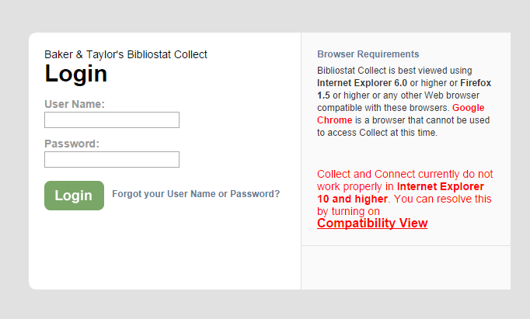

Slide 6
Expenditures & Collections
Expenditures
Collections
Make notes about any major changes
If your print/electronic materials/other materials budget has fluctuated, make sure to make a note of this, and consider whether the collection numbers reflect that change.
This should be your total holdings; not just what you’ve added this year.
On question ____, you may want to list the databases you purchased
  This helps me know how to tell you to count everything under the new database question.

Slide 7
Changes to existing data elements in library Collection:
Library collection:
It does not cover all materials (i.e., microforms, loose sheet music scores, maps, and pictures) for which expenditures are reported under Print Materials Expenditures, Electronic Materials Expenditures, and Other Material Expenditures (data elements #353, #354, and #355). Under this category report only items the library has acquired as part of the collection and catalogued, whether purchased, lease, licensed, or donated as gifts that have been purchased, leased or licensed by the library, a consortium, the state library, a donor or other person or entity. Included items must only be accessible with a valid library card or at a physical library location; inclusion in the catalog is not required. . .
Print Materials:
  Including music scores or other bound forms of printed music…
  Do not include unbound sheet music.

Slide 8
Library services
New data elements in this section:
Items that add up automatically:
Physical Item Circulation
Successful Retrieval of Electronic Information (database use)
Use of Electronic Material (replaces eBook circulation)
Electronic Content Use
Public Service Hours per Year
  This comes from all of the hours that you report for your outlet
Electronic Content Use
  Added up from Successful Retrieval of Electronic Info and from Use of Electronic Material
Total Circulation of Materials

Slide 9
Physical item circulation
Rationale: Currently, we have a data element 550 Total Circulation of Material. While the definition calls for “annual circulation of all types,” SDCs have indicated inconsistency on whether electronic circulation is counted. This proposed element would be a step toward clarifying that. By separating out physical circulation, electronic circulation (those materials that can only be loaned for a given time frame) and use of electronic information, we will then be able to look at use patterns across different types of materials, track change, and better project future use patterns.
New Element! This was formally “Total Circulation.”

Slide 10
Physical item circulation (pt. 2)
Definition:
The total annual circulation of all physical library materials of all types, including renewals.
Note: Count all physical materials in all formats that are charged out for use outside the library. Interlibrary loan transactions included are only items borrowed for users. Do not include items checked out to another library.
Examples:
Books in print
Cake pans
DVDs
CDs
Audio Books
Playaways

Slide 11
Successful retrieval of electronic information
Rationale: This proposed new element is designed to capture the use of online content provided by libraries, but does not require a traditional circulation. Primarily, this element will capture the use of paid, commercial databases. The definition borrowed heavily from NISO standards.
This element will capture the use of databases at your library.
I will fill in your MAGNOLIA information.
You will fill in your local database information.

Slide 12
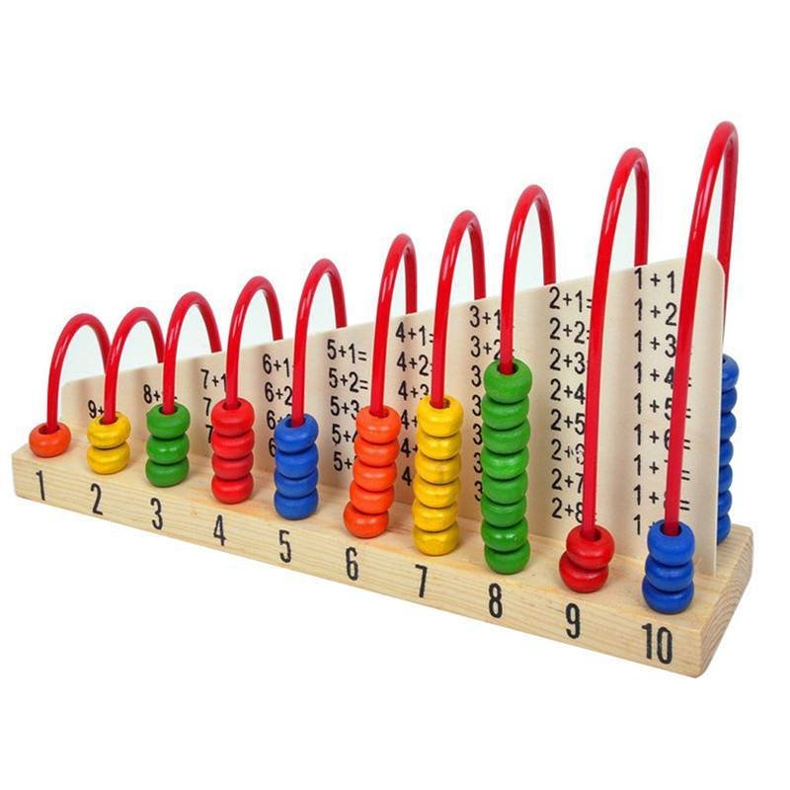
Successful retrieval of electronic information (pt. 2)
Definition:
The number of full-content units or descriptive records examined, downloaded, or otherwise supplied to user, from online library resources that require user authentication but do not have a circulation period. Examining documents is defined as having the full text of a digital document or electronic resource downloaded or fully displayed. Some electronic services do not require downloading as simply viewing documents is normally sufficient for user needs.
Include use both inside and outside the library. Do not include use of the OPAC or website. [based on NISO Standard Z39.7 (2013) #7.7, p. 43]

Slide 13
Most common locally-purchased databases
Ancestry.com
Heritage Quest
Rocket Languages (and Mango Languages)
Cypress Resume
Gale Databases
WorldBook Online
Zinio
ProQuest Databases
We will look at some best practices for counting these databases.

Slide 14
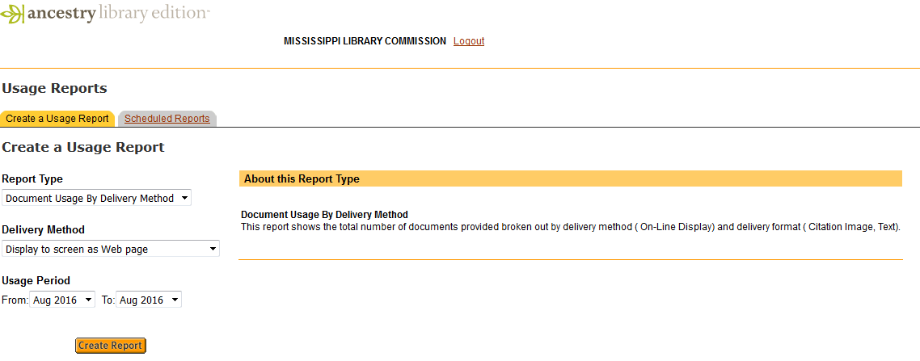
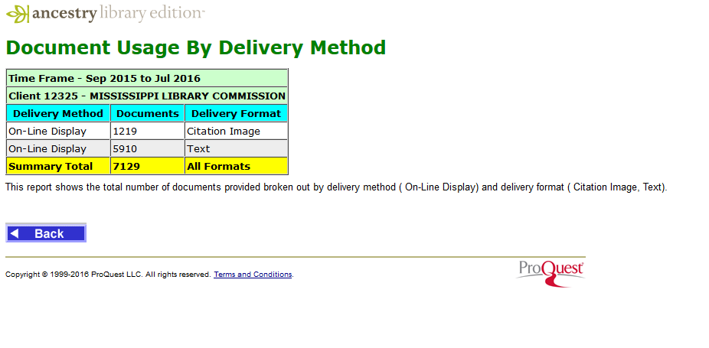
Ancestry Library Edition:
Use the total of Citation Image & Text from the summary record.

Slide 15
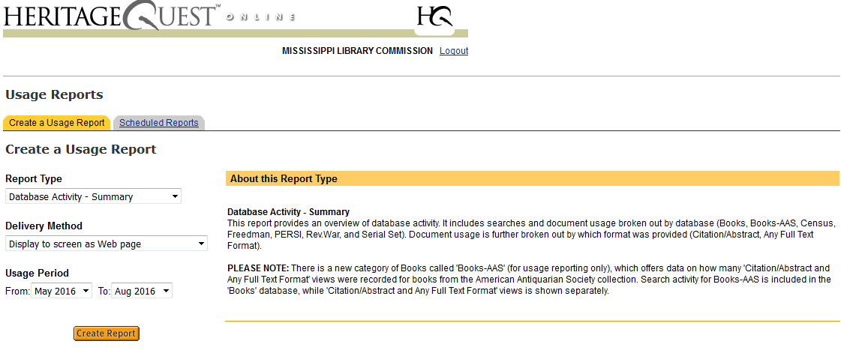
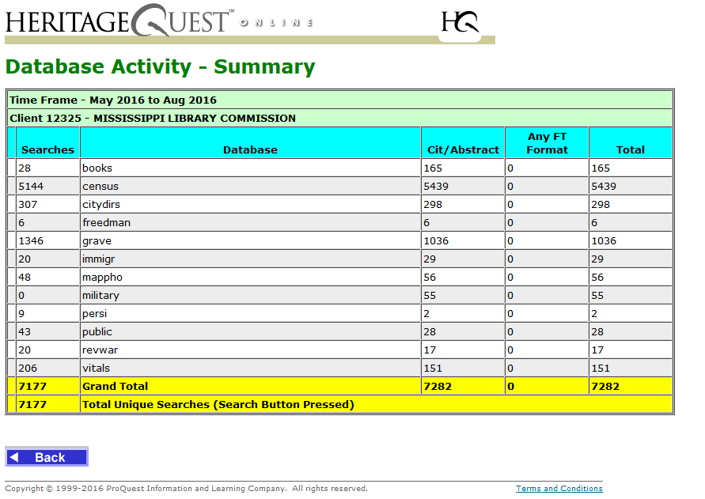
Heritage Quest:
Use the total Citation Abstracts from the summary record.

Slide 16
Popular databases
Rocket languages
Cypress resume
Gale Virtual Libraries (& other Gale databases)
Tests/Tutorials/eBooks/Courses added
Sessions
Record views

Slide 17
Popular databases
World Book Online
zinio
ProQuest Databases
Content Views*
Number of checkouts. (This is what Zinio calls this—these are not traditional circulation, as users can keep the downloaded periodical indefinitely.)
Record Views
Notes:
Note: World Book Online– The library I got this from counts searches, which is a more conservative number. But here, I chose to go with content views because the definition of this element says, “The number of full-content units or descriptive records examined, downloaded, or otherwise supplied to user…” Here, content views fits better here than searches.

Slide 18
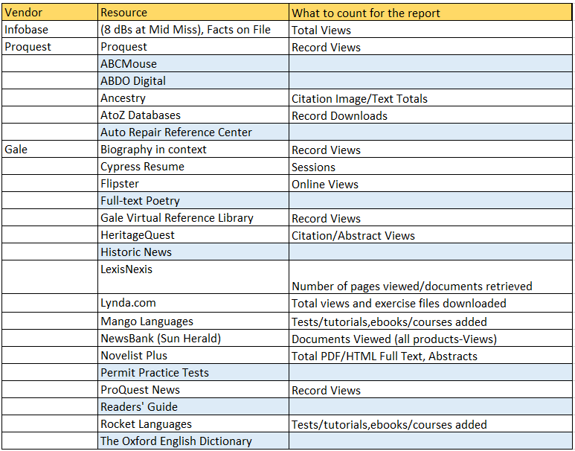
Notes:
I have created a spreadsheet of all of the databases that you have in your libraries. This sheet is still not complete, as I haven’t been able to get information back from everyone. That’s okay! This is the first year we’re counting these, and we’ll do our best. However, if you see that one of your databases is on this list and does not have any information about what to count next to it, please contact me! We can work together to answer these questions.
Further note: MLC purchases First Search; we will report those figures for your system unless you have a separate agreement with them.

Slide 19
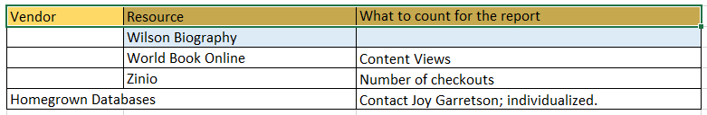
Remember that your goal is to count:
“The number of full-content units or descriptive records examined, downloaded, or otherwise supplied to the user, from online library resources that require user authentication but to not have a circulation period.”

Slide 20
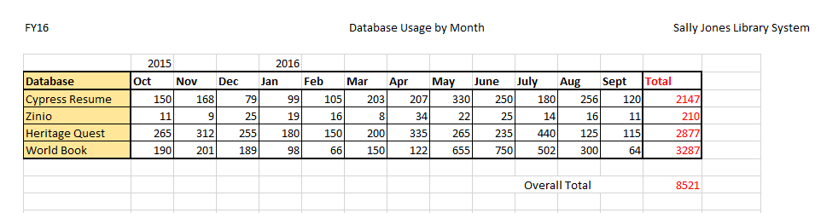
What your records might look like:
This is the number you’ll report.

Slide 21
Use of electronic material
Electronic Materials are materials that are distributed digitally online and can be accessed via a computer, the Internet, or a portable device such as an e-book reader. Types of electronic materials include e-books and downloadable electronic video and audio files. Electronic materials packaged together as a unit and checked out as a unit are counted as one use. Include circulation only for items that require a user authentication and have a limited period of use.
This was formerly E-Circulation
Change Rationale:
This change clarifies language in this element, which was approved last year.

Slide 22
Electronic content use
This new element is a calculated field: the total of 552 Circulation of Electronic Material AND 554 Successful Retrieval of Electronic Information.
This will populate automatically!

Slide 23
Total circulation of materials
This new element is a calculated field: the total of 5AA Physical Item Circulation, AND 552 Circulation of Electronic Material.
This will populate automatically!

Slide 24
Total collection use
This new element is a calculated field: the total of 553 Physical Item Circulation, 552 Circulation of Electronic Material AND 554 Successful Retrieval of Electronic Information.
And again…this will populate automatically!

Slide 25

Library Services
The rest of these questions are (pretty much) business as usual.

Slide 26
Connectivity and other electronic information
Computers and Wi-Fi:
  Count the computers as usual
  Count your Wi-Fi! This is a valuable piece of information, even if the number is subjective because of different session lengths.
  You can count this without spending a lot of money.
Use of Public Access Computers in the Library System:
  Don’t forget to do your surveys! At least once a year is necessary, but you’ll get better numbers if you do this more often.
  Don’t do percentages. Just do a straight count and multiply by the number of weeks you need to.

Slide 27

Outlet information and administrative boards

Slide 28
Deadlines/ schedule
October 3: Annual Statistical Report opens
  Webinar will be October 3 at 10:00 a.m.
December 1: Deadline for submitting report
  Certification letter
  You must go in and “SUBMIT” the report.
February 13: “Drop dead” date.
May 12: Rough draft of report tables will be sent out to all libraries

Slide 29
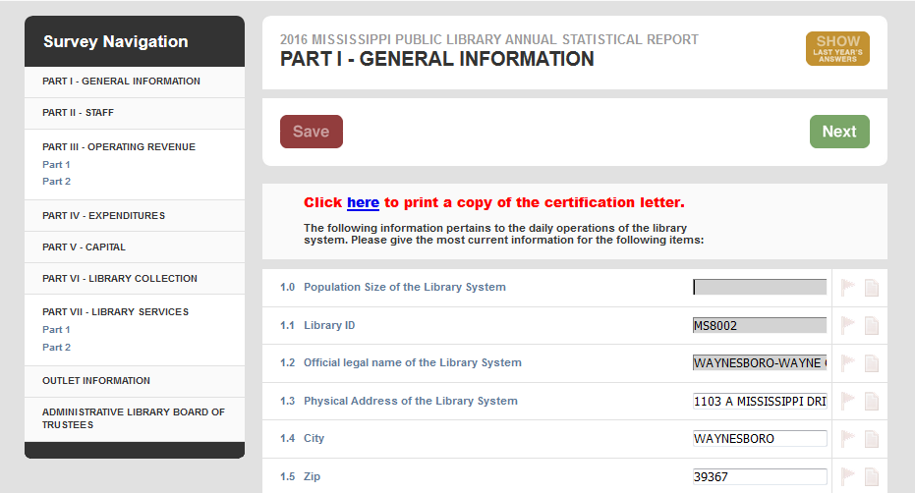
Don’t forget to print and send your certification letter.

Slide 30
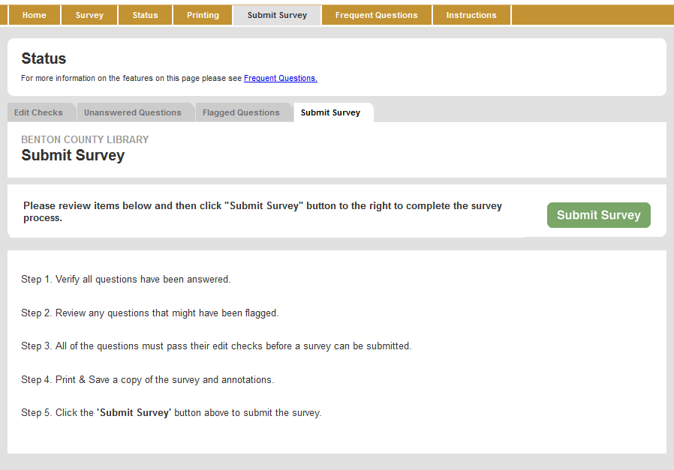
Submitting your report

Slide 31
Using your statistics
Part II

Slide 32
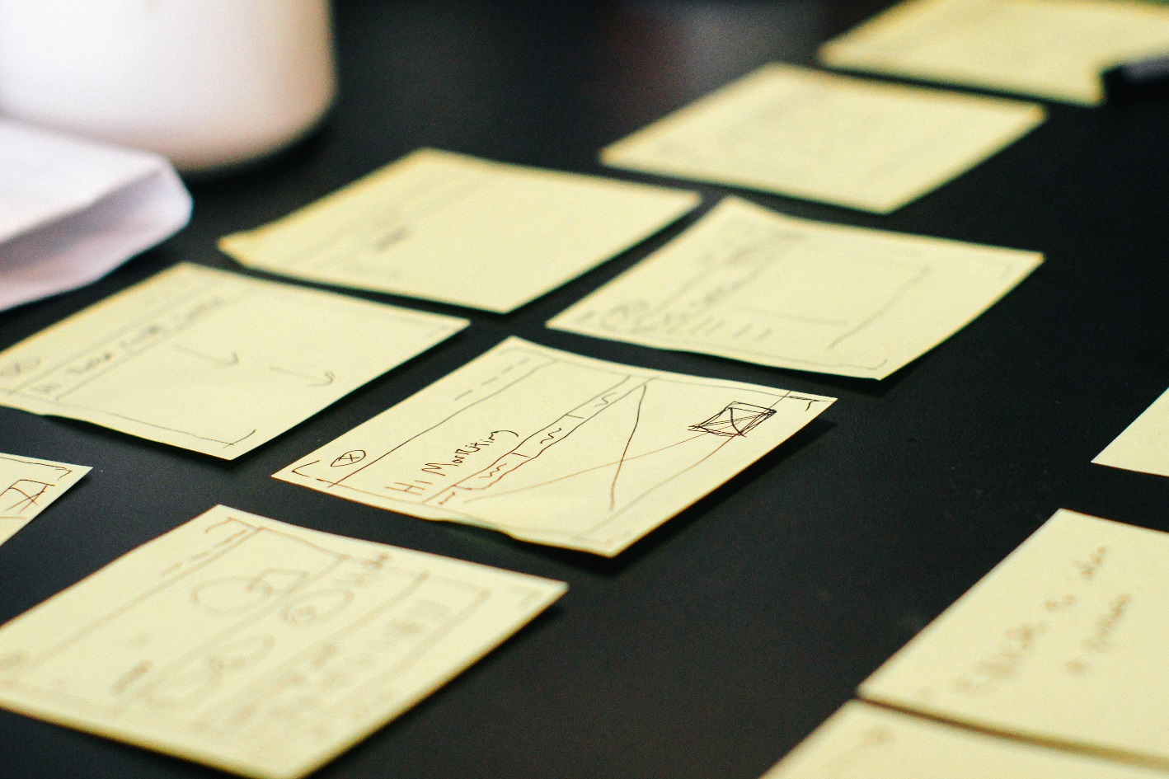
Stories from the field

Slide 33
Additional sources of information
In Mississippi
national
Mississippi Department of Employment Security: Monthly Unemployment Rates
  http://mdes.ms.gov/information-center/labor-market-information/labor-market-publications/
Census.gov, American Fact Finder:
  http://factfinder.census.gov/faces/nav/jsf/pages/index.xhtml
Annie E. Casey Foundation, Kids Count Data:
  http://www.aecf.org/work/kids-count/

Slide 34
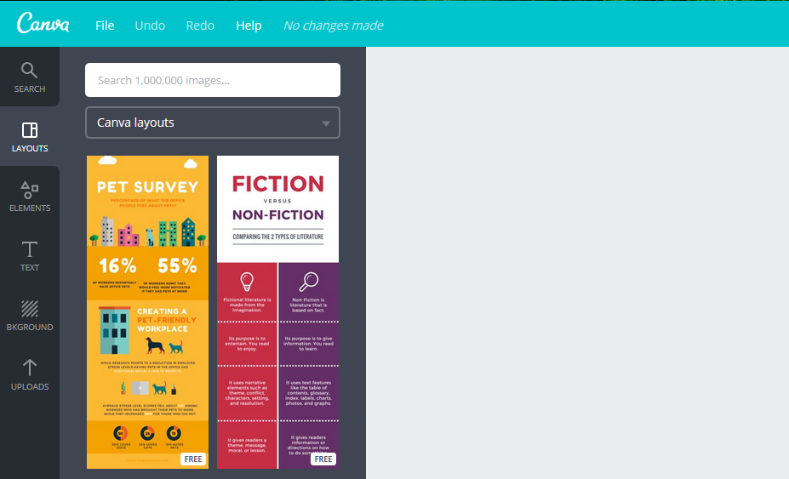
Making your own infographics
(your design here!)

Slide 35
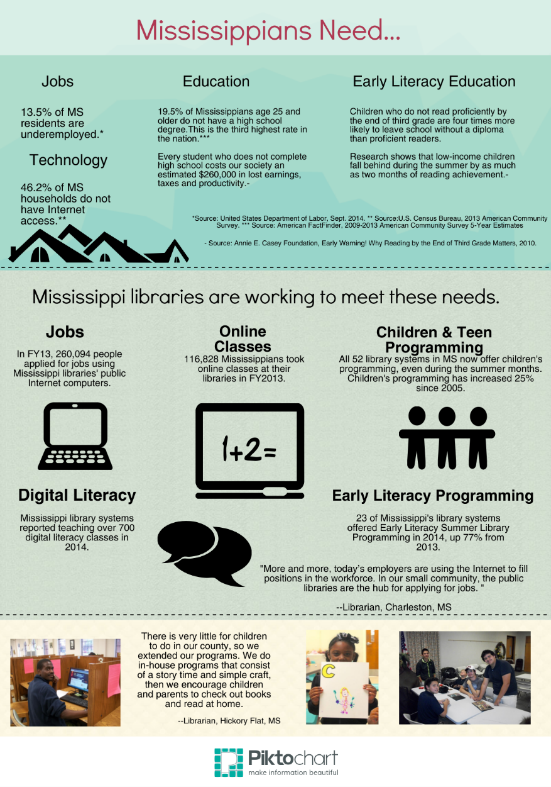
Generating your own infographics: Piktochart
Piktochart has many design options, icons, colors, and fonts.
Piktochart has good free printing options and decent paid options.
Piktochart infographics are shareable on social media.

Slide 36

Generating your own infographics: CANVA
Free software with paid options
Beautiful, designerly layouts
Templates for all kinds of presentations:
  Posters
  Infographics
  Reports
  Social media materials
  Marketing materials

Slide 37
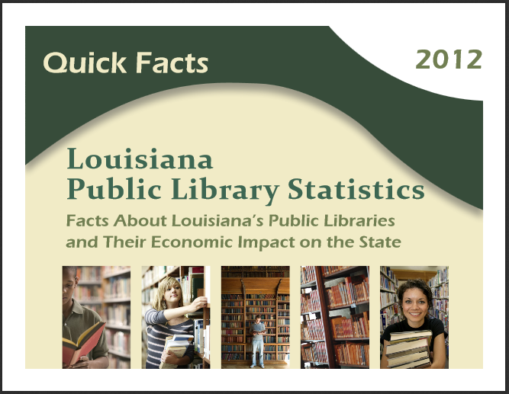
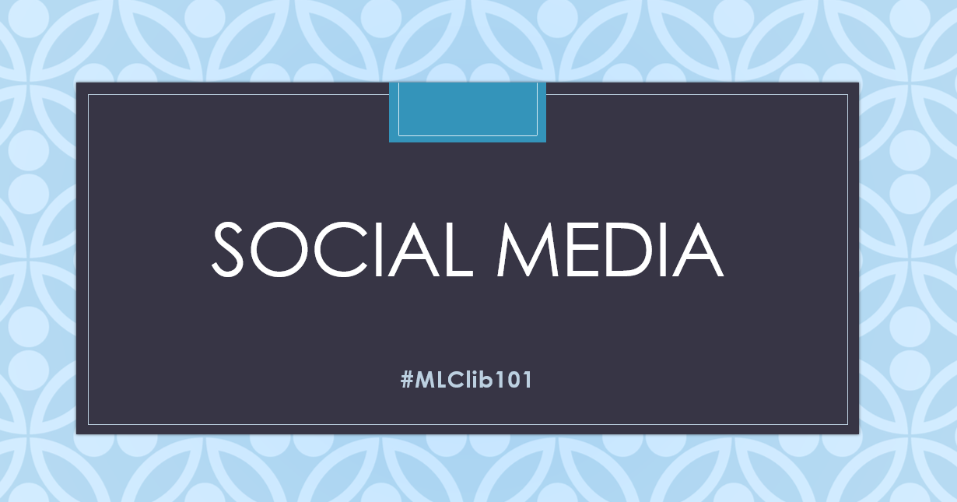
Generating your own infographics: PowerPoint
You can do longer-form infographics or board reports in PowerPoint format using the most recent version of Power Point
It’s simple, but it can be effective!

Slide 38
Questions?
Joy Garretson
Library Development Director
State Data Coordinator
jgarretson@mlc.lib.ms.us
(601) 432-4498

