Slide 1
Public Library Statistics
Joy Garretson
State Data Coordinator
MLC
601.432.4498
jgarretson@mlc.lib.ms.us

Slide 2
Revised Data Element
[502] Reference Transaction (see current definition: 502 Reference Transactions)
Reference Transactions are information consultations in which library staff recommend, interpret, evaluate, and/or use information resources to help others to meet particular information needs.
A reference transaction includes information and referral service as well as unscheduled individual instruction and assistance in using information sources (including web sites and computer-assisted instruction).Count Readers Advisory questions as reference transactions.
Information sources include (a) printed and non-printed material; (b) machine-readable databases (including computer-assisted instruction); (c) the library's own catalogs and other holdings records; (d) other libraries and institutions through communication or referral; and (e) persons both inside and outside the library.
When a staff member uses information gained from previous use of information sources to answer a question, the transaction is reported as a reference transaction even if the source is not consulted again.
If a contact includes both reference and directional services, it should be reported as one reference transaction. Duration should not be an element in determining whether a transaction is a reference transaction.

Slide 3
Notes on the Reference Transaction:
It is essential that libraries do not include directional transactions in the report of reference transactions. Directional transactions include giving instruction for locating staff, library users, or physical features within the library.
If an annual count of reference transactions is unavailable, count reference transactions during a typical week or weeks, and multiply the count to represent an annual estimate.
  Avoid holiday times, vacation periods for key staff, or days when unusual events are taking place in the community or in the library. Choose a week in which the library is open its regular hours.
Notes:
1. Examples of directional transactions include, “Where is the reference librarian? Where is Susan Smith? Where is the rest room? Where are the 600s? Can you help me make a photocopy?”
2. [If the sample is done four times a year, multiply totals by 13, if done twice a year multiply by 26, if done only annually, multiply by 52.] A "typical week" is a time that is neither unusually busy nor unusually slow.

Slide 4
You may want to use this chart:
Directional Questions | Everything Else
*Library Cards, Programs, Events, Policies, Procedures, Services (Fax, Copies, Wireless) *Where is the…(bathroom, computer sign-in station, copy machine, etc.)? | *Computer-assisted instruction *Individual unscheduled instruction *Readers’ advisory *Ready Reference *Other Reference transactions
Finding Things within the Library
*Finding a specific book or item by an author *Using the online catalog *Where are books on…(subject, etc.)?

Slide 5

New Data Element:
1. Wireless Sessions – Annually
Definition: Report the number of wireless sessions provided by the library wireless service annually.
Rationale: Wireless internet service is a key and increasing service of libraries. It makes sense to have a national statistic regarding the level of service to monitor trends and to inform local, state and national broadband policies and initiatives. The information would come from wireless service providers and/or software.
This data element will be # 652 under “Other Electronic Information” beginning with the FY2014 PLS federal survey.

Slide 6
Wifi Counting
-We have time to figure this out!
-Data from Oct. 2013-Sept. 2014 and from Oct. 2014-Sept. 2015 will be trial data.
-For those of you who are in the dark, make an appointment with us! We need to know:
  1. What kind of router you have.
  2. What kind of website/content management system you have.
  3. Whether or not you’re planning on/interested in applying for Category 2 E-Rate funds for routers/access points in the next year.
Notes:
Some routers have software that comes with them that can do counting; others are compatible with certain types of software or programs that you can acquire/configure to go with them
(For example, is your site a Wordpress site?)
3. If you are planning on filing for Category 2 finds for new routers and access points, look at what your budget can handle. You might be able to get a robust system like Cisco Meraki at up to an 85% discount.

Slide 7
Wi-Fi Counting Solutions
Hardware-Based
Software-Based
Cisco Meraki
  Between $399-$1399/AP, plus license agreement
  https://meraki.cisco.com/
Aerohive
  Between $699-$1199/AP, plus license agreement
  http://www.aerohive.com/
Open Mesh
  Roughly $60/AP, plus router. No license agreement.
  http://www.open-mesh.com/
Google Analytics
  Free but requires some technical know-how (to build a splash page, etc.)
  http://www.google.com/analytics/
Pfsense
  $99/year
  https://www.pfsense.org/
Who’s on my Wi-fi
  $7.95/month ($95.40/year)
  http://www.whoisonmywifi.com/

Slide 8


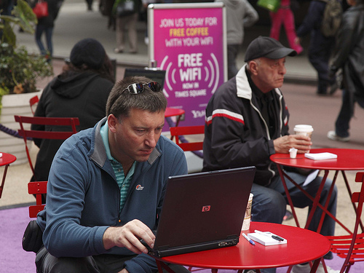
Wi-fi: Things to consider
-How long is a session length—do you count per login or per day for a single user who may leave and come back to the library?
    * (I would make one user’s session length last from 5-8hours.)
-Some routers do not keep track of individual MACs—they just count how many times people connect (so session length wouldn’t be an issue).
Notes:
I would make one person’s session length last about 8 hours. I wouldn’t put this at 24 hours because the person may leave and return at a later point. You don’t want to miss that stat.
Some systems just count the number of people connecting. If this is the case with your current software, that’s ok. If you have a chance to upgrade in the future, purchase some software that has more options that go along with it. The new Category 2 Funding parameters will make this more of a possibility.

Slide 9
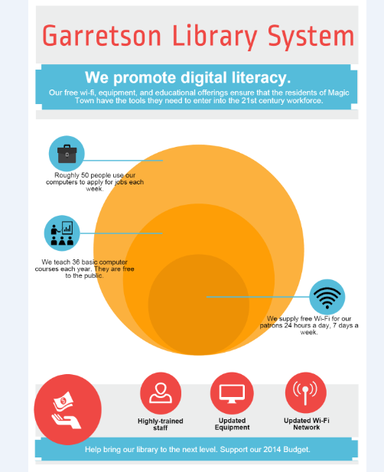
Generating your own infographics: Piktochart
Piktochart has many design options, icons, colors, and fonts.
Piktochart has better printing options than Infogr.am, even without paying for a subscription.
You can also download files from Piktochart without paying for access.
Piktochart infographics are shareable on social media.

Slide 10
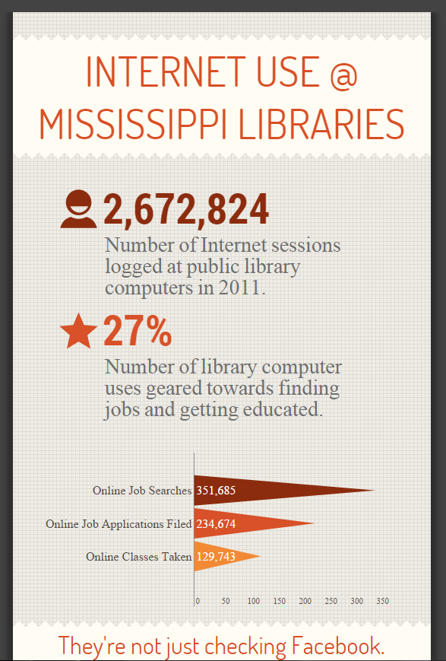
Generating your own infographics: Infogr.am
* Infogr.am has a bigger focus on charts and numbers.
* Infogr.am has fewer design options—this may be a good thing for the easily-overwhelmed.
* It’s also shareable on social media.

Slide 11

Questions? Comments?
(Rotten tomatoes?)

